Slide 1
Web Server & Apache
Authored by : Shritesh Avlani

Slide 2
Agenda
How Internet works?
Internet and Client Server Architecture.
HTTP Protocol.
What is Web Server?
Apache as a web server.
How Apache works.
PHP Overview
MVC

Slide 3
Learning Objectives
Client Server Architecture with respect to web.
How a clients request is served by the server.
What is a web server.
How apache serves as a web server.
PHP Overview
MVC Overview
Symfony Overview.

Slide 4
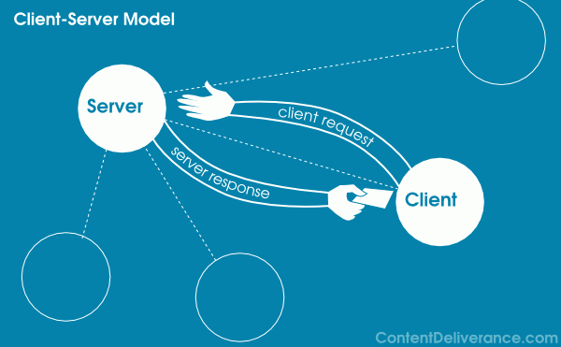
Internet and Client Server Architecture.

Slide 5
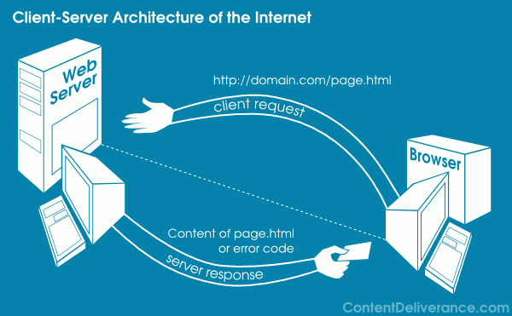
Internet and Client Server Architecture.

Slide 6
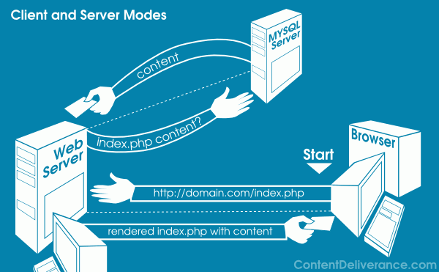
Internet and Client Server Architecture.

Slide 7
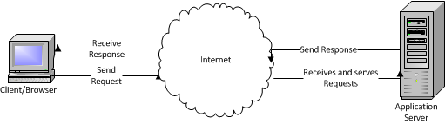
Internet and Client Server Architecture.
Client/server describes the relationship between two computer programs in which one program, the client, makes a service request from another program, the server, which fulfills the request.
Terms of Internet
  Request
  Response

Slide 8
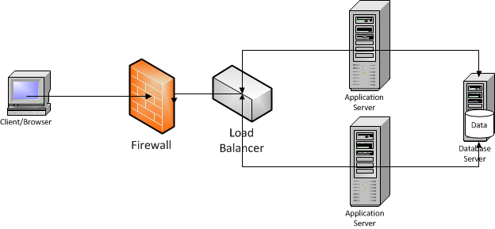
Internet and Client Server Architecture.

Slide 9
HTTP Protocol
What is a protocol?
HTTP is a set of rules, which functions as a request-response protocol in the client-server computing model.
A web browser is the client.
Application running on a computer hosting a web site may be the server.
The client submits an HTTP request message, in a GET or POST or other format, to the server.
The server, which provides resources such as HTML files and other content, or performs other functions on behalf of the client, returns a response message to the client with a status code.
  Response status Code
  200 OK
  404 Not Found
  500 Internal Server Error
  More @: http://en.wikipedia.org/wiki/List_of_HTTP_status_codes

Slide 10
What is Web Server?
A Web server is a program that, using the client/server model and the World Wide Web's
Hypertext Transfer Protocol ( HTTP ), serves the files that form Web pages to Web users ,
whose computers contain HTTP clients that forward their requests.
The primary function of a web server is to deliver web pages on the request to clients.
This means delivery of HTML documents and any additional content that may be included
by a document, such as images, style sheets and scripts.
Other Functions:
Filtering
SSL
Virtual Hosting

Slide 11
How Apache works.
  Configuration.
  Apache httpd.conf file.
    Document Root
    ErrorDocument
    AllowOverride
    Listen
  Configuring PHP
    LoadModule php5_module modules/libphp5.so
    AddType application/x-httpd-php .php
  Start and Stop Apache
  Request & Response handling.
  Creating Virtual Host.
  Apache .htaccess File

Slide 12
PHP
  Overview
  PHP is server side scripting system
  PHP stands for "PHP: Hypertext Preprocessor"
  Syntax based on Perl, Java, and C
  Very good for creating dynamic content
  Powerful, but somewhat risky!
  Typically file ends in .php--this is set by the web server configuration
  Separated in files with the <?php ?> tag
  php commands can make up an entire file, or can be contained in html--this is a choice….
  Program lines end in ";" or you get an error
  E.g.
    <P>
    <?php $myvar = "Hello World!";
    echo $myvar;
    ?>
    </P>

Slide 13
MVC
  Overview
  Architectural Pattern from Smalltalk (1979).
  Decouples data and presentation.
  Eases the development.
  Easy of Maintenance.
  Plugin Function.

Slide 14
Bibliography, Important Links
http://www.apache.org/
http://en.wikipedia.org/wiki/Web_server#Common_features
http://en.wikipedia.org/wiki/List_of_HTTP_status_codes
http://nginx.org/

Slide 15
Any Questions?

Slide 16
Thank you!

